Slide 1


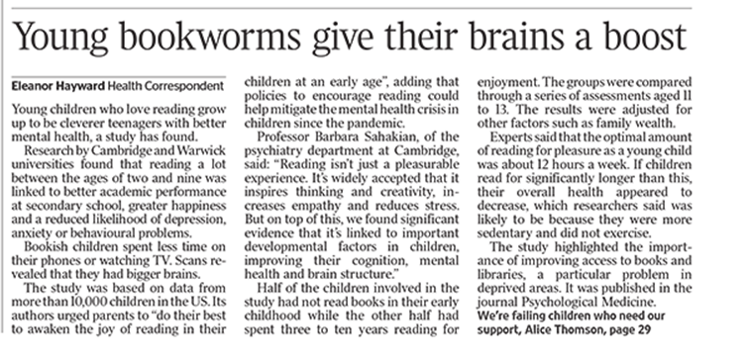

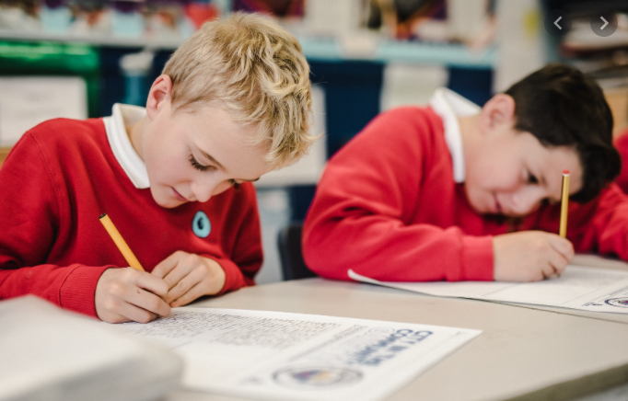
Year 5’s Welcome Evening
September 2026

Slide 2

The main aims for Year 5
For each child to feel safe and happy at school
For each child to achieve his or her full potential
For each child to develop increased independence, so that they are ready for their next steps

Slide 3
Routines
Mrs Downey – Mon, Tue, Wed & Thurs
Mrs Mair – Fridays most weeks
Mrs Bebbington throughout the majority of the week
PE, Games and swimming
Spellings – continue with whole school approach (Spelling Bee continuing)
Home Learning approach – Google Classroom
Reading (whole class)

Slide 4
Why develop independence?
Developing independence promotes self-esteem and confidence. It promotes motivation and perseverance in school.
In becoming independent, the child also gains a sense of importance and belonging. They feel they are able to contribute to the world and social life surrounding them whether at home or school. They also feel more reassured in their friendship group.
By offering children activities that make them more independent, you allow them to gain confidence. While teaching them new skills, you also help them to develop qualities such as patience, concentration, self-help, cooperation, self-discipline and self-trust.
Independent pupils are much more likely to enjoy and succeed at secondary school! Preparing them for this starts now!

Slide 5
What independence looks like in Year 5/Our Expectations
Responsibilities within school
Hand in own letters, slips etc. from home
If pupils lose home learning etc.. Being responsible for asking for a new copy themselves
Organising their own home learning schedule
Self-organisation – they should know the days they need PE kit etc.
Deliver some messages to home instead of letters
Initiative – encouragement to solve problems themselves
Think Three before raising hand for help – What did the teacher say? What is there to help me? Can I ask a friend?
Choices and consequences – The Delph Ways
Children speaking to adults in school themselves as a first step in dealing with any issues/children using the ‘can we talk’ box
Care for uniform, equipment, own possessions and those of others.
Children looking for lost items themselves!
Being an older role-model/coach to younger peers in school
Regular chores at home
Tying own shoelaces

Slide 6
Delph Primary School’s Life Skills
Year 5
At Delph Primary School, we aim to develop the whole child, embedding technical and transferable elements of the hidden curriculum alongside the age-related National Curriculum expectations.
Delph Primary School’s Life Skills are our way of supporting and ensuring that our children grow into well-rounded, confident young people who can succeed as individuals and contribute to our community. The objectives listed below are age-appropriate skills that your child must demonstrate they can independently carry out before the end of this academic year. Together, with your support, we can empower our children to be school ready and life ready.
Please discuss the targets with your child and work on them together. When you feel they are secure in this life skill, tick the box next to each statement, as school will do too.
 | Home | School
I dress appropriately for all weather conditions, without being instructed
I can ride a bike
I have an understanding of a saving – bank account/piggy bank
I can make and change my own bed (removing and adding bedding)
I can accurately tell the time using the 24-hour clock in both analogue and digital formats
I can set an alarm to get myself up in the morning
I can wrap a present for a birthday, Christmas or other special event
I can write and send an email, note or letter (including comments on Google Classroom)
I can pack and unpack my own bag for swimming
I can ask for extra copies of letters, home learning etc… myself
I am comfortable with staying overnight at a friend's, relative or residential

Slide 7
Home Support
Parental help with home learning, reading, spelling, times tables is vital (even at this age!).
Independence/chores at home
Encourage TT Rockstars at least 3 times per week
E-safety – social media responsibility. Is your child ready to enter this world?
Screen time before bed
How to deal with an issue when playing out/online
Can take books from school for reading

Slide 8

These can be purchased on websites such as Amazon for approximately £5.00 and will really help you and your child with their maths journey this year. Ensure to select the book for their year group.

Slide 9
Visits/Trips
Bolton Museum – October 2026
Half termly local walk
Other visits to be arranged, including an overnight stay at Castleshaw in May 2027 (more information to follow)
Please prepare your child for this – packing own bags, making own beds, sleeping out, organising self etc…

Slide 10
Uniform Reminders
There have been some updates to our policy. Please support us with this from September.
Information is on our website under “Uniform Expectations”

Slide 11

New Home/School Agreement
Please take two copies and sign both. Please leave one in school for your child to sign.

Slide 12
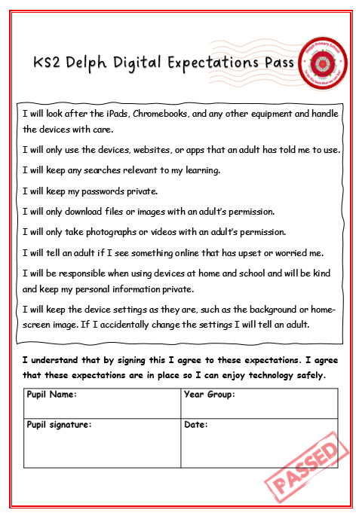
New Digital Expectations Pass
Please take a copy for your information.

Slide 13
Swimming
Year 5 will swim in the second half of this Autumn Term on Wednesday afternoons, up to Christmas.
We swim at Saddleworth Baths in Uppermill.
The lessons are led by swimming teachers who follow Oldham’s programme. This includes water safety.
Please encourage your child to pack/unpack their own swimming bag each week.
Any concerns with this, please talk to us! Mrs Bebbington will accompany the class and support.

Slide 14
Contact
Pass a message via the office or office email (not class teachers’ email as they may get missed). Class teachers are not expected to check emails regularly as they are setting up for lessons and or working with pupils
If urgent phone not email
Jot a note on paper (remind your child to show us)
Google Classroom to submit larger pieces of homework and general updates
Delph Primary School website, Health & Wellbeing Page

Slide 15
We’re looking forward to working in partnership with you to ensure pupils have a productive, happy and successful year …
Please trust that we absolutely want the best for your child and make all decisions with the pupils’ best interests at the centre!
Please take a Year 5 End of Year Expectations Booklet with you!

Slide 16
Questions
Are there any questions?

