Slide 1
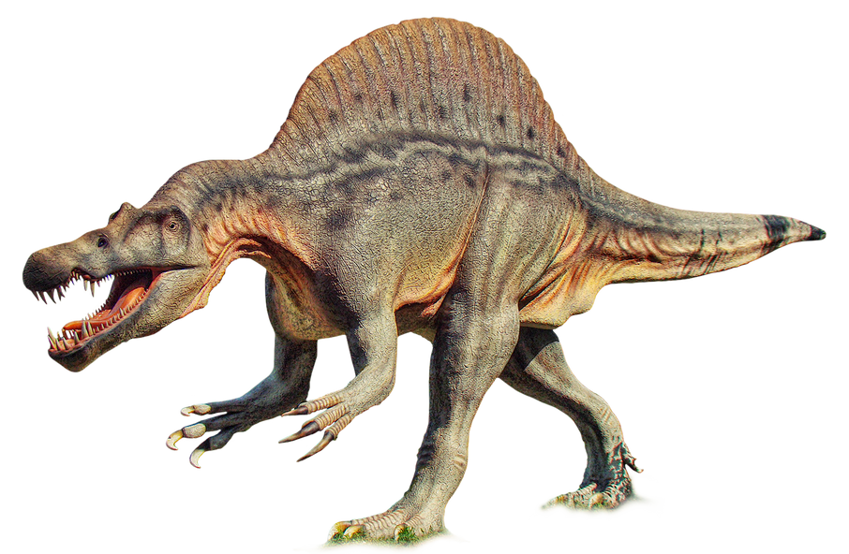
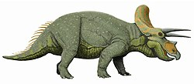
Understanding the World
Use books to help children understand the past
Share with children what the world looked like during the Jurassic era
How do we know dinosaurs existed? No one has ever seen them, so what evidence do we have? How do we know what they looked like? Look at skeletons, fossils as evidence
Explore changing states of matter by freezing toy dinosaurs, investigate how they could be freed. Explain that some dinosaurs have been found in similar conditions – called glaciers
Dinosaur dig: sort skeletons out into different dinosaurs & work out from their skeleton what type of dinosaur they were from their shapes
Group dinosaurs into different categories: 4 legged, 2 legged, those that fly
Introduce words: carnivore, herbivore, omnivore. Look at the characteristics depending on the type of food they eat
Introduce predators & prey, & discuss how their appearance helped them keep safe
Look at features such as horns, claws, tails as key in different species of dinosaur
Mathematics
Count & sort dinosaurs into trays, by colour, type & recount
Encourage children to practice linking numerals to their cardinal value, counting the correct number of dinosaurs and matching to the written number on the nest
Create painting stamps in the shape of a dinosaur footprint. Dip the stamp into paint & print onto strips of paper using different colours to create patterns
Challenge the children to continue, copy & create repeating patterns
Positional language: behind, next to, under, on top, in-front using dinosaurs on a background
Weighing out ingredients for dinosaur biscuits: understanding that we need to weigh ingredients accurately if they are to taste nic
Use regular shapes to create to create a dinosaur
Sequencing/pattern: introduce patterns of 3 & then using different dinosaurs encourage children to independently produce their own pattern
Introduce language: tall /short, fat/thin, big/small
NCETM being followed as a scheme as well as Hamilton Trust SOW
PSED
Make a large dinosaur egg & hide it in the classroom. Share a letter with the children from a mother dinosaur who has lost her egg
Discuss with the class how the mother must feel & how they can care for the egg
How would it feel if a dinosaur came to school? What problems might there be? Size? Behaviour? How would we help them?
Why might it be difficult being their friend? How might we welcome them?
For circle-time: pass a soft toy dinosaur around the circle. Invite children ton talk about their favourite dinosaur
Encourage the children to express their feelings & consider feelings of others
Why is it important to look after our environment?
What does extinct mean?
What skills does a paleontologist have? Patience, perseverance
Expressive Art & Design
Draw & paint a dinosaur of own choice, paying attention to shape, number of legs, horns, tail etc.
Show children how to mix colours to get a different tone by adding black or white to make it darker or lighter
Personalise it with a name that combines own name with ‘…asaurus’ or ‘…tops’
Use art straws of varying lengths to make the shape of a dinosaur skeleton
Invite children to work collaboratively to create a dinosaur using chalk & natural materials in the outdoor area
Encourage children to explore music, using a variety of instruments to compose music to sound like a dinosaur
Invite children to create a dinosaur dance to perform, using a sequence & the music made
Dinosaurs Roar!
Outdoor Provision
‘We’re Going on a Dinosaur Hunt’: walk around the school grounds as part of the introduction to school. Pick up clues on the way around
Use chalks and water-sprays to draw out dinosaurs & labelling words
Create a dinosaur den for the explorers to observe the dinosaurs from
Big sponge painting as a collaborative piece
Literacy
Share a variety of fiction & non-fiction text & develop language through storylines
What do we already know about dinosaurs? Write what the children say to display in the classroom
Using a picture of a dinosaur, label the parts. Sound out the words together & write them
Dinosaur fact-file: look at examples of fact files, what needs to be included? Create class dinosaur fact-file
Mark making: do a story map from one of the books that we look at. Act out the story with actions to retell the story and narrate
Introduce vocabulary linked to dinosaur display e.g. marshes, volcano
Continuous Provision
‘Tough Tray’ with small world dinosaur environment. Encourage sorting & appropriate dialogue
Dinosaur role-play to encourage language development
Large dinosaurs to use in the role-play area alongside the explorers set
Free painting of dinosaurs and relevant scenes
Construction toys e.g. stickle bricks: set challenges to make different dinosaurs, using the different shapes
Playdough: make dinosaur shapes & add features using different tools
Dinosaur hunt in the sand tray: clean, wash & sort the different types of dinosaurs buried
Writing area: appropriate mark making
Physical Development
Children can practice their motor skills by using a range of tools & their hands to shape & mould playdough to make dinosaurs
Encourage children to explore different ways of moving & combining different movements e.g. stomp, fly, creep
Invite children to create a sequence for different types of dinosaurs & perform their sequence
Digging & scraping dinosaurs from the sand using a brush – archaeological style
Use a variety of key words to develop language e.g. stomp, thud, scamper, creep, stalk
Communication & Language
Invite children to learn a selection of dinosaur themed songs & rhymes
Encourage children to listen carefully to how the songs & rhymes sound & explore different rhythms & sound patterns
Engage children in story times and non-fiction texts about dinosaurs
Support children to learn new vocabulary & ask questions to find out more information
Read the story ‘Hide-a-Saurus’ to the children. Once they have developed a familiarity with the text, encourage them to retell it using their own words & some exact repetition.
Use the ‘Hide-a-Saurus’ scenes and cut-outs to encourage the children to use new vocabulary from the story. Can they remember the dinosaur names & describe the settings?

