Slide 1
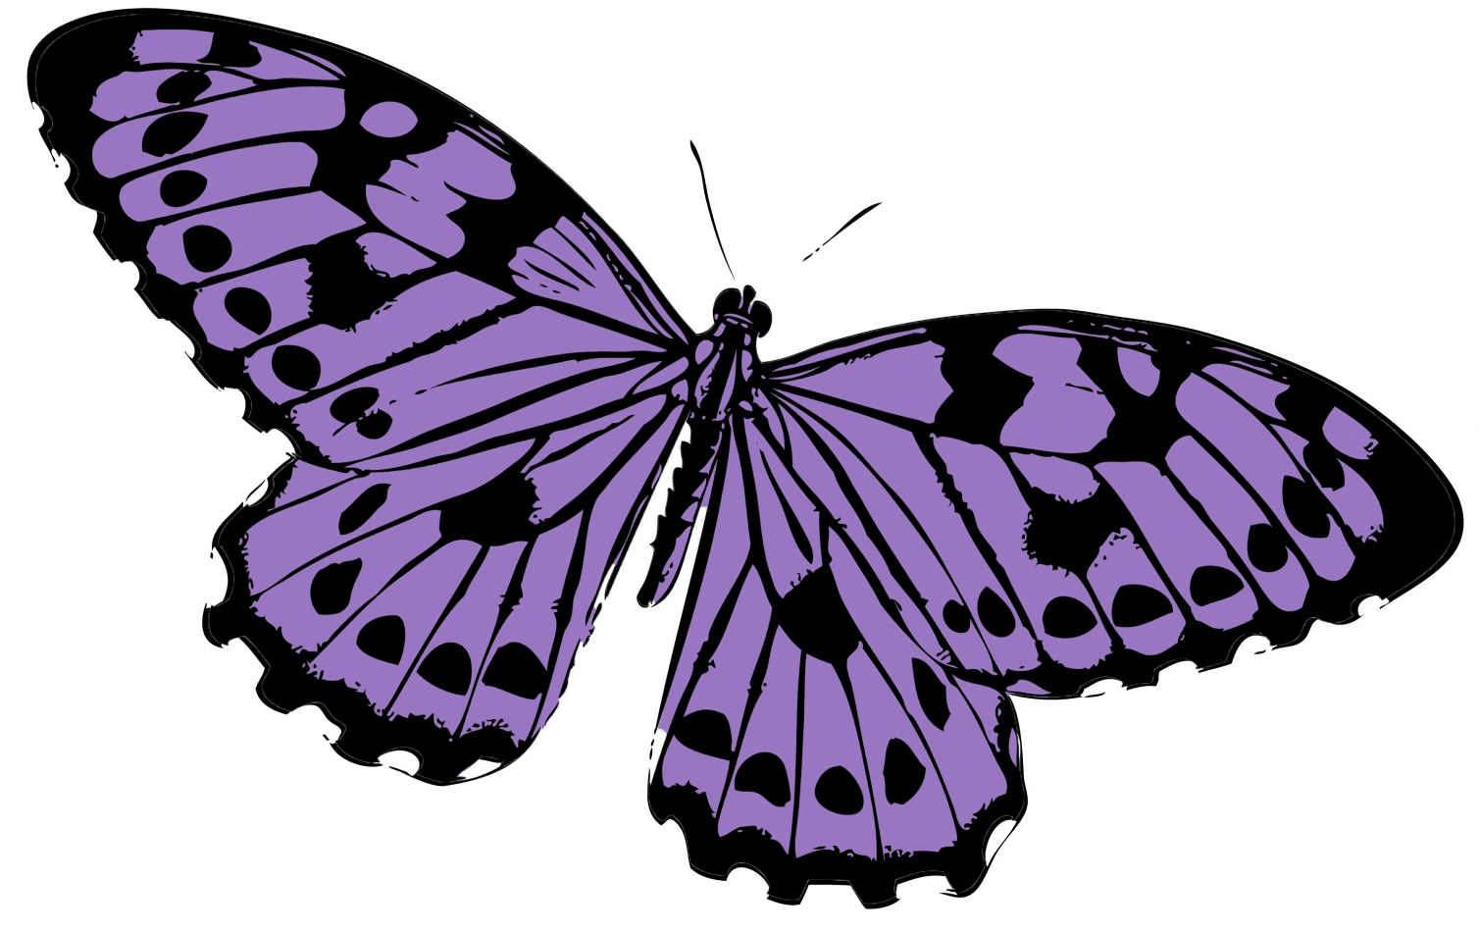
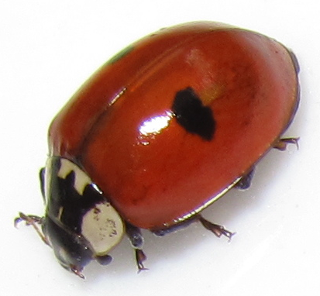
Understanding the World
Go on a bug hunt around school identifying the best places to find them.
Where are mini-beasts natural habitats and why?
What purposes do mini-beasts serve in our environment, e.g. spiders, flies, bees?
Talk about the life cycles of specific bugs. Look at how some of them change e.g. butterflies. Identify that most bugs hatch out of eggs.
How do mini-beasts help us?
Understand that all living things have a life cycle. Recap our life cycle.
Some mini beasts can only be found in certain places and countries.
Mathematics
Use White Rose Maths, Hamilton Maths & Number Blocks Schemes of Work
Ladybird Game-Orchard Games
Counting ladybird spots and adding the 2 wings together.
Measure mini-beasts using a piece of string-use appropriate language long, longer, longest.
Repeat patterns of caterpillar body circles 4/5 colours to create a whole caterpillar.
Favourite bugs graph. Relate questions to interpret the data collected.
Tally charts- bugs spotted outside.
Symmetry- butterflies
Count how many items of food the hungry caterpillar ate.
Introduce Venn diagrams- characteristics of different bugs e.g. legs, wings, antennae
Shapes and designs within insects.
PSED
How can we show people and animals that we care about them?
When something goes wrong in your family who tries to make it right again?
The Bad Tempered Ladybird- Feelings
Treating animals with care and putting them back
Explain to the children that mini-beasts are helpful creatures that do lots of good work. For example, spiders often make their webs in doorways (it’s like a welcome), worker bees work really hard to help look after the queen, and ants help to gather food for everyone who lives in their ant hill. Encourage children to think of things they do at home or at school that are kind and helpful.
Encourage the children to work together in teams to create mini-beast houses in the block/construction area.
Expressive Art & Design
Encourage the children to make some temporary mini-beast models and sculptures using natural materials, such as leaves, flowers, petals and feathers.
Look at and discuss ‘The Snail’ picture by Henri Matisse. Encourage the children to create their own snail collage pictures.
Use percussion instruments to make sounds to accompany different mini-beasts. Encourage the children to think about which instrument would be best for each mini-beast and how they should be played (quiet/loud, slow/fast).
Teach children a selection of mini-beast songs to learn by heart. Some of the songs in this ‘mini-beast Songs and Rhymes Pack’ might be helpful.
Provide the children with stones and paint. Children can decorate their stone to look like a mini-beast, such as a bee, ladybird or butterfly. Use them to decorate a small world area or outdoor space.
At the Bottom of the Garden!
What is an insect? Do all mini-beasts have 6 legs?
Outdoor Provision
Set up some ’Bug Hotels’. Plan what they will look like and where best to place them.
Do a ‘Bug Identification’ tally chart when we have spotted mini-beasts in our outdoor area.
Draw and label bugs seen.
Use the camera to take a picture and identify.
Set up a bug explorers set for outside use.
Literacy
Share a variety of fiction & non-fiction text & develop language through storylines e.g. The Ugly Bug Ball, The Hungry Caterpillar, The Bad Tempered Ladybird, The Very Lazy Cricket, What the Ladybird Heard
Phonics – Follow Ruth Miskin lessons
Worde Aware – learn about words linked to farms e.g. mini-beast, insect, thorax, abdomen
Daily handwriting – names, phonic letters, numbers
The Very Hungry Caterpillar- re write the order of foods eaten in a book. Do a book of what favourite things we like to eat.
Rewrite the story and what happened at the beginning and end of the story.
Write mini-beast fact-files
Label the life cycle of a butterfly.
Write invitations to the ‘Ugly Bug Ball’. Plan a party and what we would need.
Label a bug, sounding out the key parts of the animal.
Instructions on how to make a honey sandwich.
Look at a selection of mini-beast poems and rhymes to read and learn.
Reading research material we find through espresso and google.
Teddy Bears Picnic morning-writing activities associated with it.
Continuous Provision
‘Tuff Tray’- mini-beasts habitat
Sand – Find mini-beasts in the sand and under stones
Role-play - mini-beasts puppets and masks
- Explorers mini-beast hunt
Water - Capacity: full, empty, half full
Construction – Use junk modelling to make
Paint – Dip tractor tyres/farm animals in paint and produce prints on large sheets of paper
Malleable – Use ‘mini-beast Playdough Mats’
Daily handwriting – letters, numbers
Physical Development
Play a piece of music called ‘Fantasy in C’ by Georg Philipp Telemann. Encourage the children to create a butterfly dance and explore different ways of moving to the music. The children could incorporate the following:
  - different heights (moving while stretched up tall and while crouched down)
  - moving different parts of their body (for example sweeping arms high and low)
  - listening to the tempo of the music (speeding up and slowing down with it)
  - stopping to visit flowers for nectar as they travel around
Play some mini-beast-themed music or songs and encourage the children to move to the music. For example, you could use ‘The Flight of the Bumblebee’ by Nikolai Rimsky-Korsakov.
Place hoops in the outdoor area. Encourage the children to jump between the hoops like grasshoppers.
Communication & Language
Word Aware
Teach a selection of mini-beast themed songs & rhymes, encourage children to listen carefully to how the songs & rhymes sound & explore different rhythms & sound patterns
Engage children in story times and non-fiction texts
Support children to learn new vocabulary e.g. insect, abdomen, thorax
Listening Station – variety of familiar stories
At the beginning of the topic, ask the children to think of any questions they have about mini-beasts and what they would like to learn. Encourage them to share their questions so that they can be explored during their learning on mini-beasts.
Encourage children to talk about their experiences of mini-beasts. Ask them to share which mini-beasts they like to see and why.
Look at this Mini-beasts Videos PowerPoint. Encourage children to talk about the different mini-beasts they can see. Can they use topic related vocabulary, such as ‘slow’, ‘fast’, ‘fly’, ‘slimy’, ‘shell’, ‘buzz’?

